Slide 1
INVESTMENT CASE STUDY SUBMISSION
Group Name:
Anuj Panchal
Utkarsh Dhawan
Ashwini Ingale
Pooja Manjarekar

Slide 2
Abstract
Spark Funds, an asset management company. Spark Funds wants to make investments in a few companies. An effective analysis based on Investment type, country and sector wise can help to make best choice.
Business Understanding
Data Source | Investment data from crunchbase.com
Constraints | Invest between 5 to 15 million USD per round of investment. Invest only in English-speaking countries for the ease of communication.
Strategy | Identify the best sectors, countries, and a suitable investment type for making investments.
Business Objective | Invest to the ones 'where most investors are investing'.

Slide 3
Problem solving methodology
The real investment data from crunchbase.com
This row data is then imported into system using python
Data
Collection
Inspection has been done on row data by using python manipulation.
Further we have removed NaN values, discarded unused columns in process of data cleanup.
Data Inspection & Cleanup
We have done 3 type of analysis:
Investment Type : Based on average funding amount Highest funding type were selected.
Country Wise : Top 3 English-speaking country were identified by investment amount.
Sector Wise : Top 3 sector were selected based on different conditions.
Data
Analysis
Final observation have been captured in Tableau for effective demonstration.
Data
Visualization

Slide 4
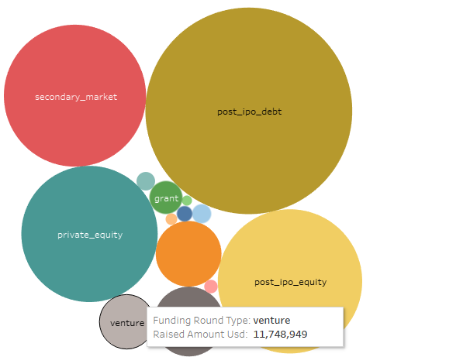
Analysis (Investment type)
Investment Type
Companies under analysis | 66368
Suitable investment type between 5M to 15M USD | Venture

Slide 5
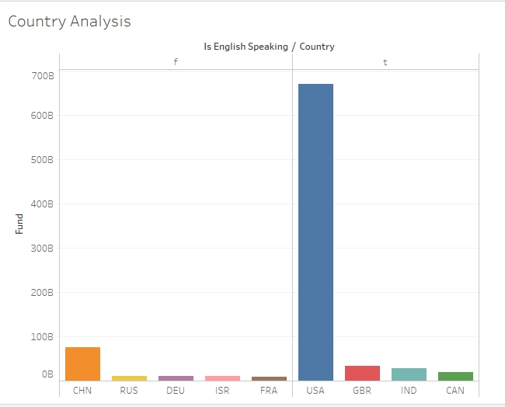
Analysis (Country wise)
Country Wise
Top 9 country based on investment | USA,CHN,GBR,IND,CAN,RUS,DEU,ISR,FRA
Top 3 English Speaking country | USA, GBR, IND

Slide 6
Investment Analysis (Sector wise)
Sl.no | Questions | USA | GBR | IND
1 | Total number of Investments (count) | 12063 | 621 | 328
2 | Total amount of investment (USD) | 1.07318E+11 | 5365228300 | 2949543602
3 | Top Sector name (no. of investment-wise) | Others | Others | Others
4 | Second Sector name (no. of investment-wise) | Social, Finance, Analytics, Advertising | Social, Finance, Analytics, Advertising | Social, Finance, Analytics, Advertising
5 | Third Sector name (no. of investment-wise) | Cleantech / Semiconductors | Cleantech / Semiconductors | News, Search and Messaging
6 | Number of investments in top sector (3) | 2950 | 147 | 110
7 | Number of investments in second sector (4) | 2714 | 133 | 60
8 | Number of investments in third sector (5) | 2300 | 128 | 52
9 | For point 3 (top sector count-wise), which company received the highest investment? | Virtustream | Electric Cloud | FirstCry.com
10 | For point 4 (second best sector count-wise), which company received the highest investment? | SST Inc. (Formerly ShotSpotter) | Celltick Technologies | Manthan Systems

Slide 7
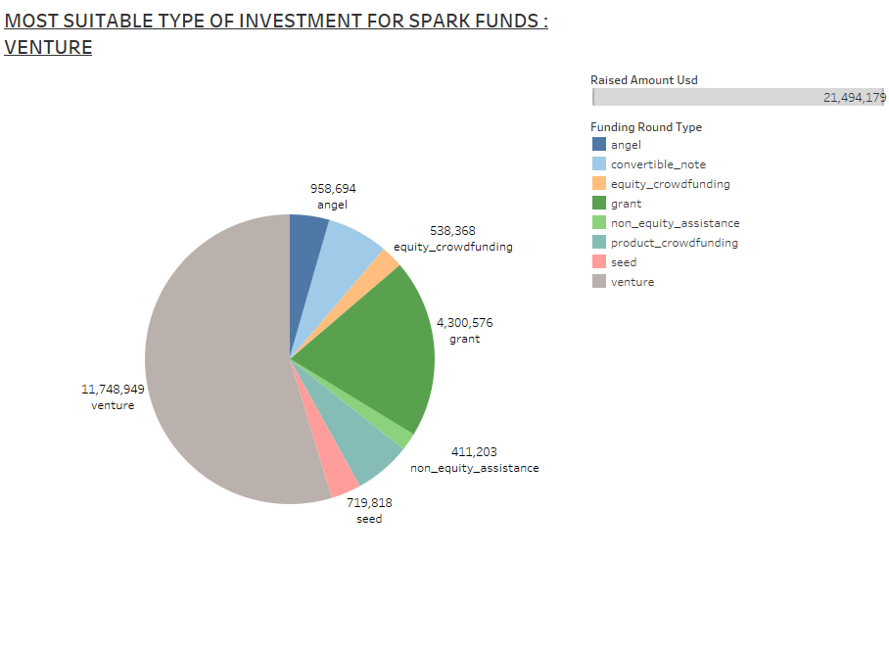

Slide 8
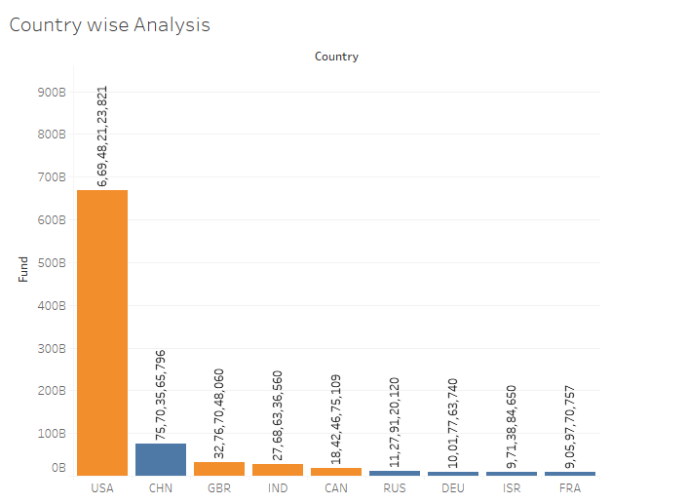
English speaking countries which got the most investments for ’Venture’ type of funding

Slide 9
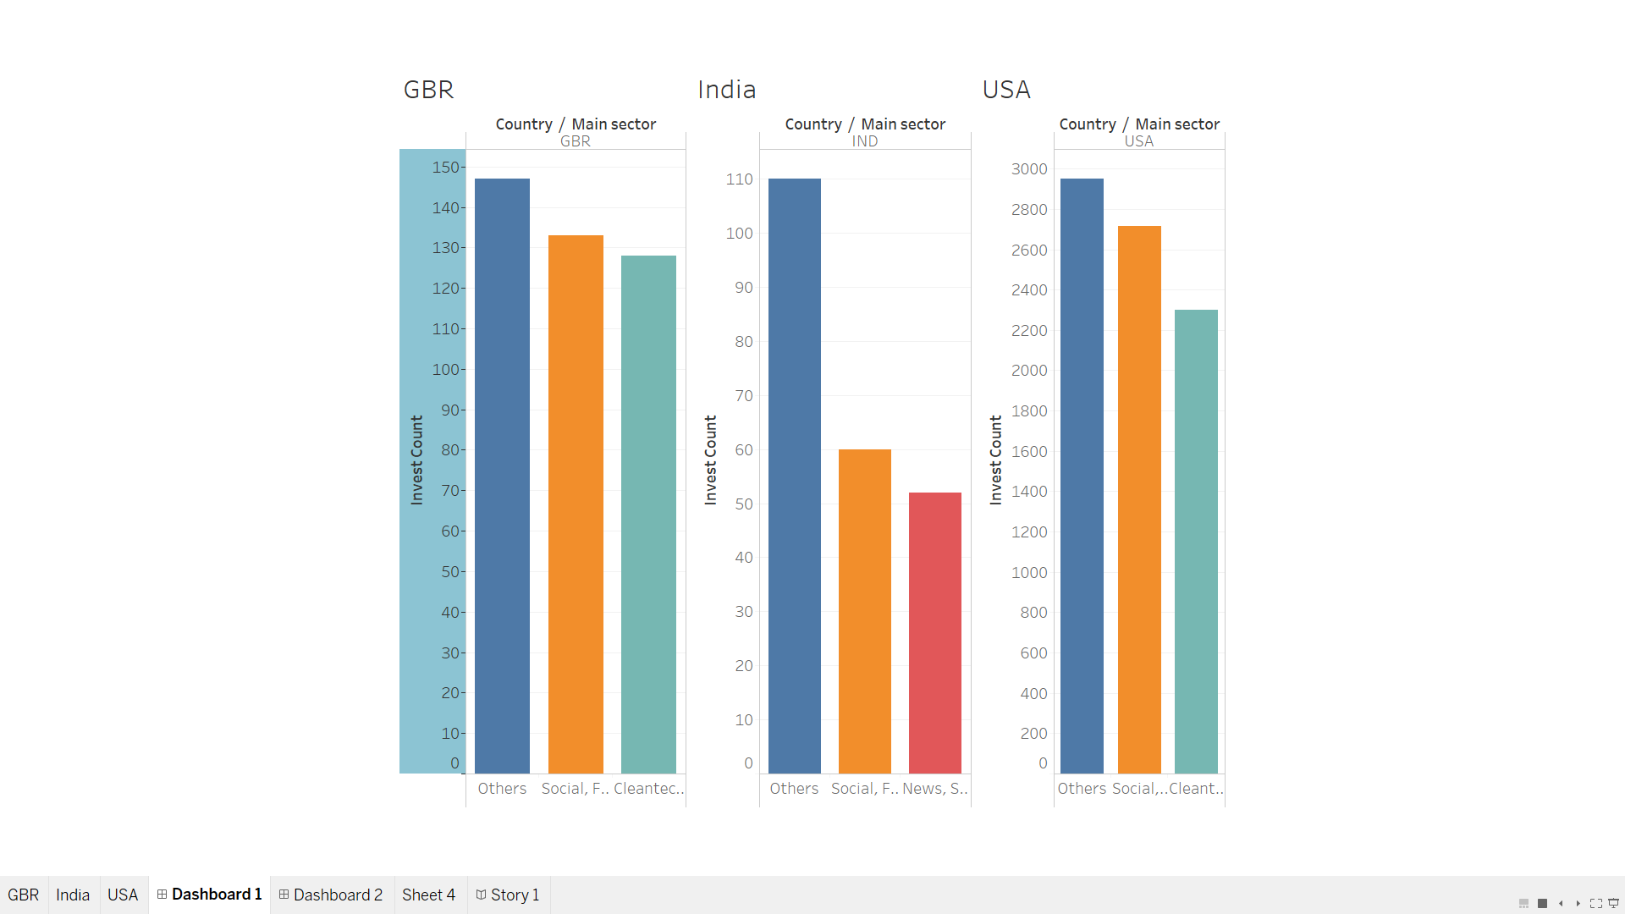
Investments made in the top 3 sectors in the top 3 countries

Slide 10
Conclusions
Most suitable and feasible area of investment for the spark funds is to invest in the funding type ‘VENTURE’.
Three of the main English speaking countries are: USA, Great Britain and India, in which the company can invest for Venture type of funding.
Some of the most highly valuable sectors to invest in Venture type funding are : ‘Others’ and ‘Social, Finance, Analytics, Advertising’.
Highly recommended sectors to invest in Great Britain and India are ‘Cleantech/Semiconductors’ and ‘News/Search and Messaging’.

